Slide 1
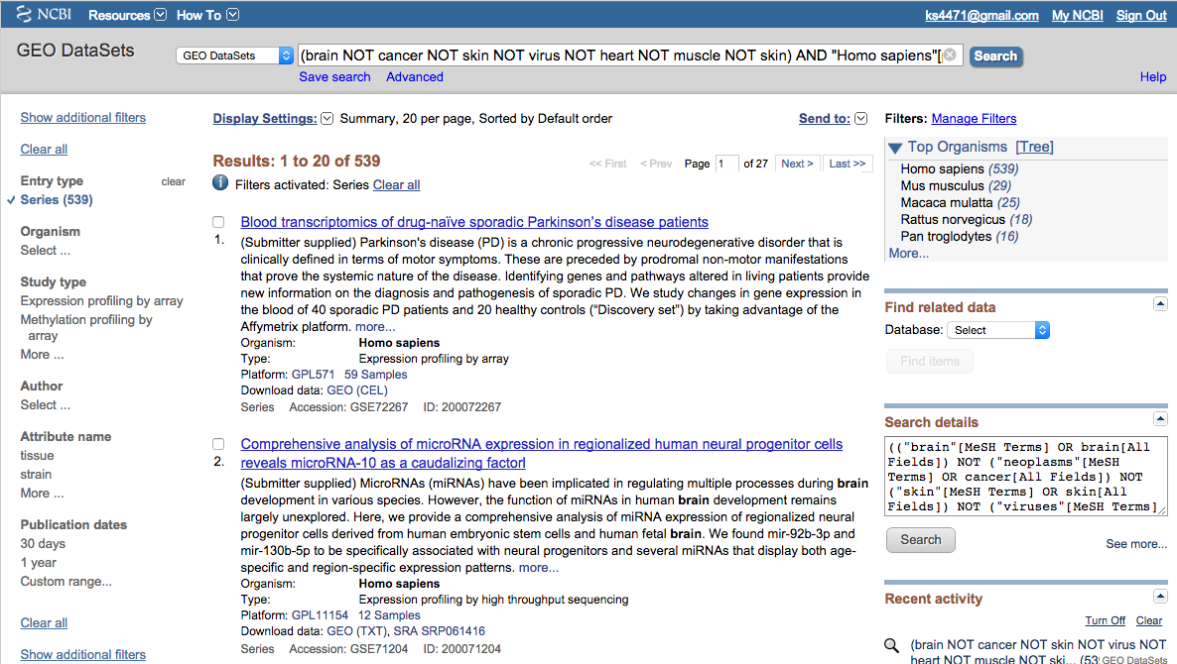

Slide 2
Search Parameters :
Brain
NOT cancer NOT skin NOT virus NOT heart NOT muscle NOT skin
Human
Full Dataset |  |  |  | Contains Expression Data |  |  |  | Disease Only
Type | n | % |  | Type | n | % |  | Type | n | %
other | 395 | 68% |  | other | 307 | 67% |  | Parkinson's | 34 | 23%
Parkinson's | 35 | 6% |  | Parkinson's | 34 | 7% |  | Alzheimer | 28 | 19%
Alzheimer | 33 | 6% |  | Alzheimer | 28 | 6% |  | other.disease/disorder | 20 | 14%
other.disease/disorder | 26 | 5% |  | other.disease/disorder | 20 | 4% |  | Schizophrenia | 14 | 10%
Schizophrenia | 20 | 3% |  | Schizophrenia | 14 | 3% |  | Major.Depressive | 13 | 9%
Major.Depressive | 16 | 3% |  | Major.Depressive | 13 | 3% |  | Autism | 9 | 6%
Autism | 12 | 2% |  | Autism | 9 | 2% |  | Bipolar | 7 | 5%
Bipolar | 7 | 1% |  | Bipolar | 7 | 2% |  | Epilepsy | 6 | 4%
Amyotrophic.Lateral.Sclerosis | 6 | 1% |  | Epilepsy | 6 | 1% |  | Multiple.Sclerosis | 5 | 3%
Epilepsy | 6 | 1% |  | Multiple.Sclerosis | 5 | 1% |  | Amyotrophic.Lateral.Sclerosis | 4 | 3%
Multiple.Sclerosis | 6 | 1% |  | Amyotrophic.Lateral.Sclerosis | 4 | 1% |  | Neurodegenerative.disease | 3 | 2%
Neurodegenerative.disease | 5 | 1% |  | Healthy | 4 | 1% |  | Huntington's | 2 | 1%
Healthy | 4 | 1% |  | Neurodegenerative.disease | 3 | 1% |  | Rett | 2 | 1%
Huntington's | 3 | 1% |  | Huntington's | 2 | 0% |  | Downs | 1 | 1%
Downs | 2 | 0% |  | Rett | 2 | 0% |  | TOTAL | 148
Mental.Retardation | 2 | 0% |  | Downs | 1 | 0%
Rett | 2 | 0% |  | TOTAL | 459
TOTAL | 580
 |  |  |  | n.samples>122 | 47 |  |  | n.samples>122 | 14

Slide 3
14 datasets with > 122 samples
Disease Only
Type | n | %
Parkinson's | 34 | 23%
Alzheimer | 28 | 19%
other.disease/disorder | 20 | 14%
Schizophrenia | 14 | 10%
Major.Depressive | 13 | 9%
Autism | 9 | 6%
Bipolar | 7 | 5%
Epilepsy | 6 | 4%
Multiple.Sclerosis | 5 | 3%
Amyotrophic.Lateral.Sclerosis | 4 | 3%
Neurodegenerative.disease | 3 | 2%
Huntington's | 2 | 1%
Rett | 2 | 1%
Downs | 1 | 1%
TOTAL | 148

Slide 4
Who are these guys..?
legend
same study
blood samples
SESN3
14 datasets with > 122 samples
Dataset Description | n | id | class | details
Circadian patterns of gene expression in the human brain and disruption in major depressive disorder | 670 | GSE45642 | Major.Depressive | 55 subjects, 34 controls 6, brain regions
Genetic control of human brain transcript expression in Alzheimer's disease. | 363 | GSE15222 | Alzheimer | 187 controls, 176 cases
Genetic Differences in the Immediate Transcriptome Response to Stress Predict Risk-Related Brain Function and Psychiatric Disorders | 320 | GSE46743 | other.disease/disorder | 2 time points, 91 cases, 69 controls
Alzheimer's Disease Dataset | 253 | GSE48350 | Alzheimer | 4 brain regions
A gene co-expression network in whole blood of schizophrenia patients is independent of antipsychotic-use and enriched for brain-expressed genes | 239 | GSE38485 | Schizophrenia | blood
Microarray profiling of PFC, HPC and STR from subjects with schizophrenia, bipolar, MDD or control | 205 | GSE53987 | Schizophrenia | 19 samples, 3 brain regions, 3 diseases & 1 control
A gene co-expression network in whole blood of schizophrenia patients is independent of antipsychotic-use and enriched for brain-expressed genes [HumanHT-12 V3.0] | 202 | GSE38484 | Schizophrenia | blood
Alzheimer's disease and the normal aged brain (steph-affy-human-433773) | 161 | GSE5281 | Alzheimer | ~19 samples, 6 brain regions
Disrupted functional neworks in autism underlie early brain maldevelopment and provide accurate classification | 147 | GSE42133 | Autism | blood
Autism and increased paternal age related changes in global levels of gene expression regulation | 146 | GSE25507 | Autism | blood
Autistic children and their father’s age: peripheral blood lymphocytes | 146 | GSE25507 | Autism | blood
Whole-genome gene expression and splicing analysis of midbrain neurons derived from human embryonic stem cells: relevance to Parkinson's disease | 138 | GSE34865 | Parkinson's | 94 samples (fetal), 57 control adult,
Genetic Neuropathology of Obsessive Psychiatric Syndromes | 133 | GSE60190 | other.disease/disorder | 2 diseases - 15 + 16 case, 102 controls
Chronic temporal lobe epilepsy: biopsy hippocampus | 129 | GSE63808 | Epilepsy | 129 human hippocampus

Slide 5
Code.txt
Summary of the code used for all major parts of the methods section
Description of functions used and basic examples of loops used
Someone with expertise would be able to understand and reproduce
Not disclosing any of our own functions used in pipelines

